Slide 1
Deep Learning in Computer Vision (Part-4)
Transformer Models
Computer Vision, 6th Semester, 2024

Slide 2
Transformer model
Primarily used for NLP (Natural Language Processing) tasks
Extended to all media
Converts embeddings of input data into a desired output format
Attention mechanism:
allows the model to weigh the importance of different words in a sequence when processing it
capturing long-range dependencies and relationships in the data more effectively than previous architectures

Slide 3
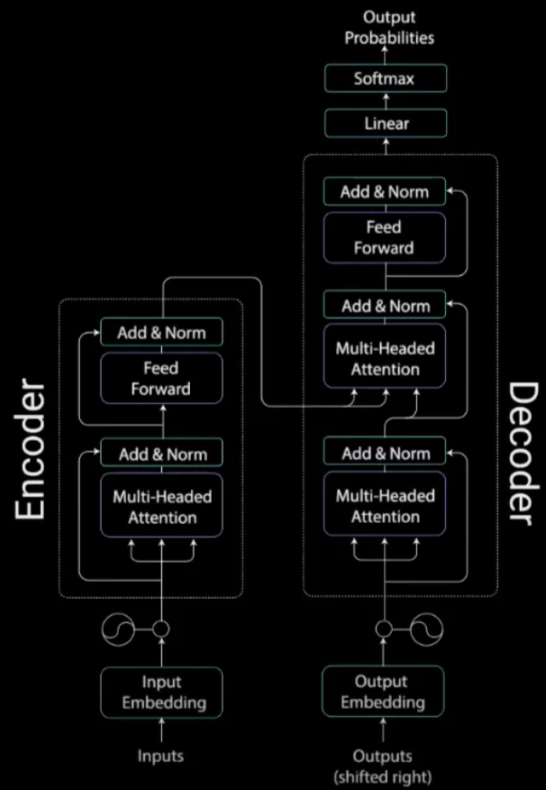
Architecture of a transformer model
Similar to the autoencoder architecture, a transformer model has two parts:
Encoder
Decoder
The difference lies in the components of the two networks comprising the transformer.
Source: Illustrated Guide to Transformers- Step by Step Explanation, by Michael Phi
https://towardsdatascience.com/illustrated-guide-to-transformers-step-by-step-explanation-f74876522bc0

Slide 4
Components of the transformer model
Input Embeddings:
The initial representation of the input data is transformed into vectors using embeddings.
Encoder-Decoder Stacks:
Encoder: A stack of identical layers, each of which consists of two main components:
Multi-Head Self-Attention Mechanism:
Allows the model to weigh the importance of different parts of the input when processing it.
Computes a weighted sum of all input vectors for each position based on the similarities between query, key, and value vectors.
Allows the model to focus on different parts of the input simultaneously by using multiple sets of query, key, and value projections, known as "heads."
Enables the model to capture various types of relationships and dependencies in the data
Feed-Forward Neural Networks (used to transform the data after the attention mechanism in each layer)
Decoder:
A similar stack of identical layers as the encoder, but with an additional multi-head self-attention mechanism that attends to the encoder's output.
It generates the output sequence based on the context provided by the encoder.
Positional Encoding:
Transformers do not have any built-in notion of the order or sequence of the input data, unlike RNNs.
Positional encodings are added to the input embeddings to give the model some notion of the order or position of the input tokens.
Layer Normalization and Residual Connections:
Techniques used to stabilize and improve the training of deep networks
Normalizing the inputs to each layer and adding skip connections that allow gradients to flow more easily during training.

Slide 5
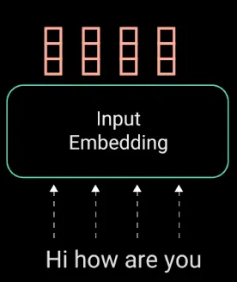
Input Embedding
Conversion of input data into numeric vectors or embeddings
A word embedding layer:
A lookup table to grab a learned vector representation of each word.
Each word maps to a vector with continuous values to represent that word.

Slide 6
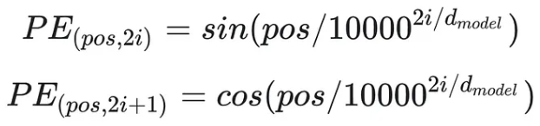
Positional Encoding
Provision of positional information to the model so as to provide contextual notion (sequential information), since, unlike in RNNs, the transformer encoder has no recurrence.
Simplest encoding:
sine model for even position entities
cosine model for odd position entities

Slide 7
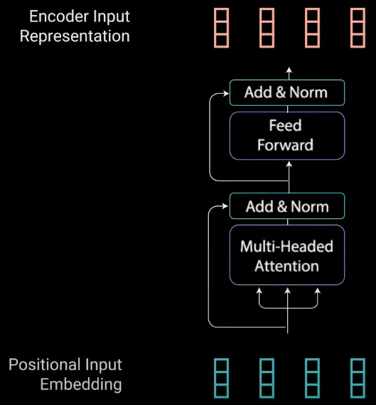
Encoder Stack
Task:
Map all input sequences into an abstract continuous representation that holds the learned information for that entire sequence

Slide 8
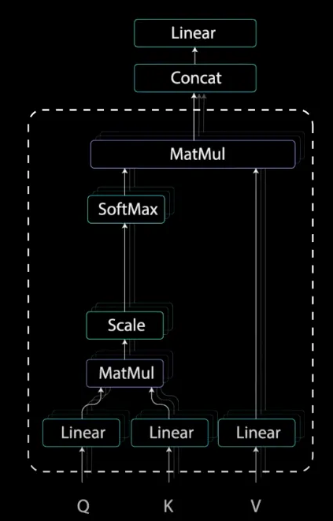
Multi-Head Attention
Query (Q): A vector used to compare with all keys.
Key (K): A vector used to determine how much focus to place on other parts of the input.
Value (V): A vector that gets weighted by the attention scores and is used to compute the output.
Basically, a “query” input is matched with candidate “keys” to predict suitable “values”.

Slide 9

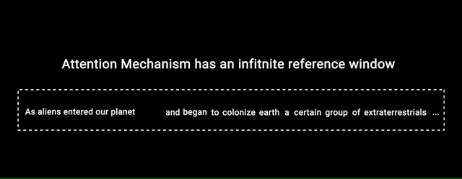
Attention mechanism – example
The Attention mechanism enables the transformers to have extremely long term memory.
A transformer model can “attend” or “focus” on all previous tokens that have been generated.
RNN’s have a shorter window to reference from, so when the story gets longer, RNN’s cannot access words generated earlier in the sequence.
The attention mechanism, in theory, and given enough compute resources, have an infinite window to reference from, therefore being capable of using the entire context of the story while generating the text.

Slide 10
Attention vs Self-attention
Attention mechanism
Self-attention mechanism
Can be applied to any type of input, not necessarily sequences.
Query, Key, and Value vectors can come from different sources or sequences.
Captures dependencies between different sequences or parts of the input.
Specifically used where the input and output sequences are the same.
Query, Key, and Value vectors all come from the same input sequence.
Captures dependencies between different positions in the same input sequence.

Slide 11
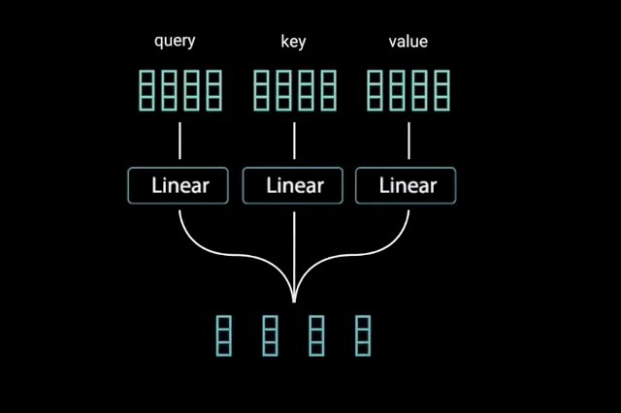
Attention calculation: 1
Dot product multiplication of queries and keys to get a score matrix

Slide 12
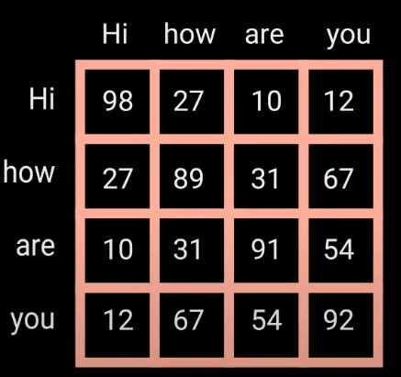
Attention calculation: 2
Score matrix determines how much focus should a word be put on other words.
Each word will have a score that corresponds to other words in the time-step.
The higher the score the more focus.

Slide 13
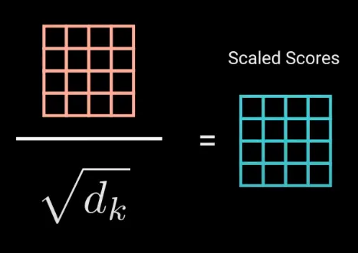
Attention calculation: 3
Scale-down of scores:
Division by the square root of the dimension of query/key.
Allow for more stable gradients, as multiplying values can have exploding effects.

Slide 14
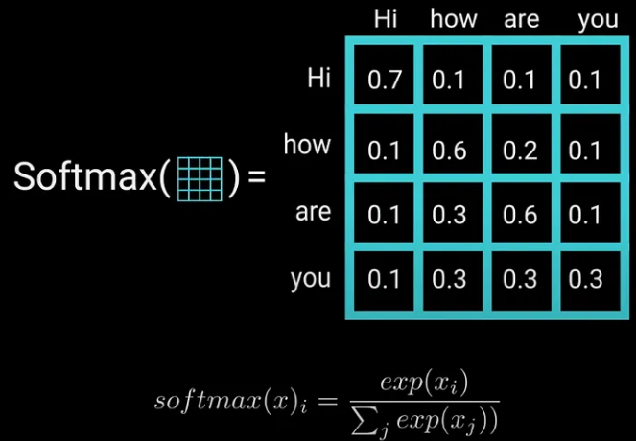
Attention calculation: 4
Softmax of the scaled score to get the attention weights
Probability values [0~1].
Higher scores are heightened.
Lower scores are depressed.
Allows the model to be more confident about which words to attend to.

Slide 15
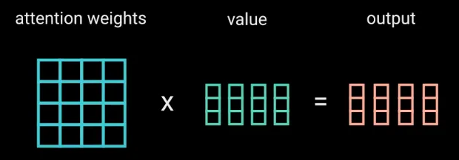
Attention calculation: 5
Multiplication of attention weights with value vectors to get output vectors
The higher softmax scores will keep the value of words deemed more important by the model.
The lower scores will drown out the irrelevant words.

Slide 16
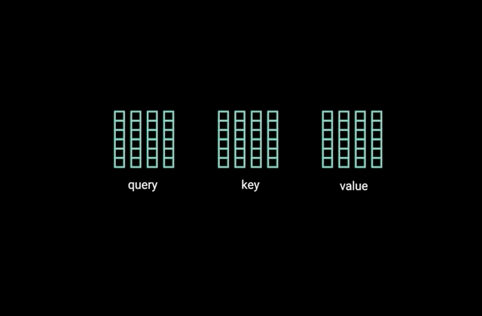
Attention calculation: 6
Multiple self-attention projections / “heads”:
Allow the model to focus on different parts of the input simultaneously and capture various types of relationships.
Each Q-K-V vector set is split into N heads for multiple attention learning.
The outputs from all the attention heads are concatenated and linearly transformed to maintain model dimensionality.

Slide 17
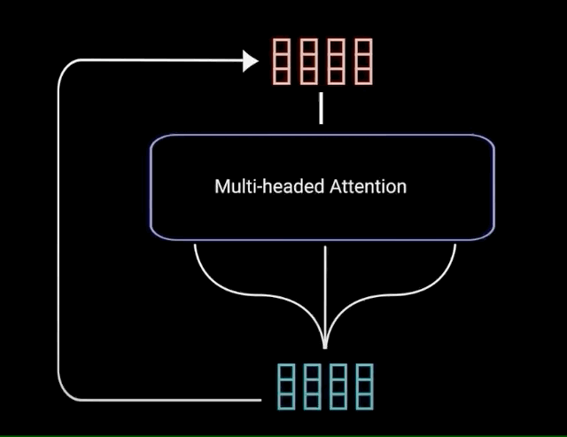
Attention calculation: 7
Residual connection:
The multi-headed attention output vector is added to the original positional input embedding.

Slide 18
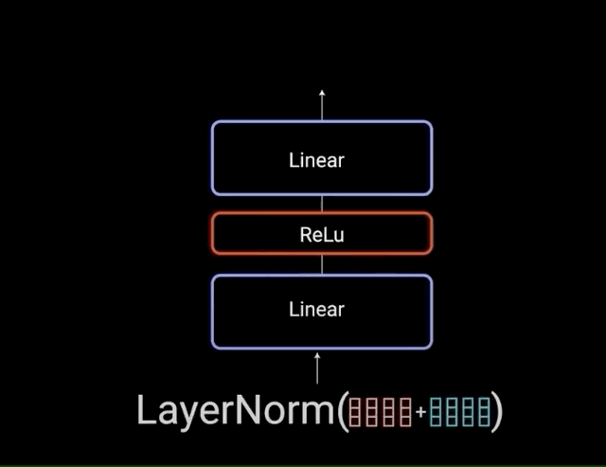
Attention calculation: 8
Residual connections
Allow gradients to flow through the networks directly
Layer normalizations
Stabilize the network
Reduce training time
Pointwise feedforward layer
Project the attention outputs
Richer representation

Slide 19
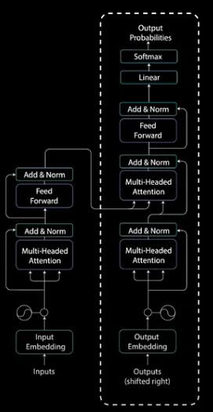
Decoder stack
(Shown in dashed box)
Similar to encoder stack, but two multi-head attention modules are utilized.
Process:
Potential output sequences are embedded, similar to input sequences.
Attention mechanism is applied twice.
Input computations with attention information is fed in the second attention module.
Outputs are the probabilities of matching output embeddings with input embeddings.
They can hence be mapped to the suitable media.

Slide 20
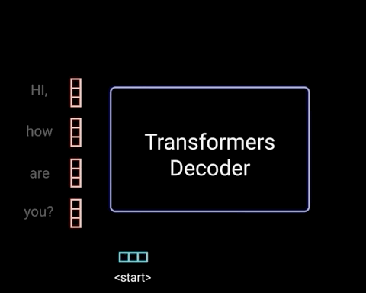
Decoder Working
Computation of outputs from input embeddings and usable predictions
Auto-regressive model:
Begin with a start token
Take in a list of previous outputs as inputs, and the encoder outputs containing attention information from input
Stop decoding when it generates a token as an output

Slide 21
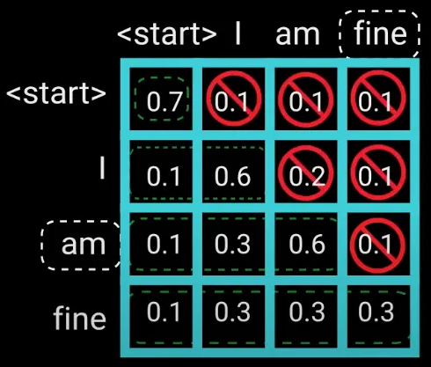
Attention calculation: 9
Decoder-side attention calculation for output generation
Since the model is auto-regressive, generating one token at a time, there is a need for the model to not generate scores for “future” tokens, i.e. a generated token should “attend” to itself and words BEFORE it.

Slide 22
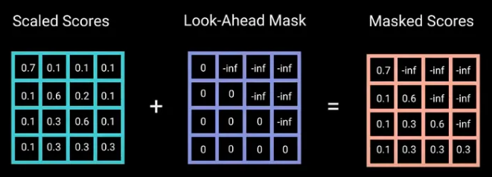
Attention calculation: 10
Masking:
Method to prevent computing attention scores for future words
To prevent the decoder from looking at future tokens
Apply a look ahead mask
The mask is added before calculating the softmax, and after scaling the scores

Slide 23
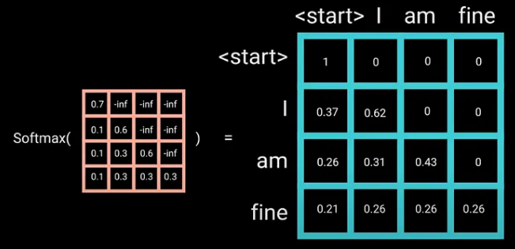
Decoder softmax From Masked scores
Softmax of the masked scores
Negative infinities get zeroed out
Zero attention scores for future tokens

Slide 24
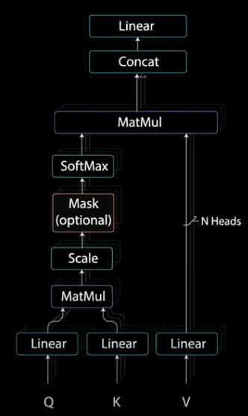
Decoder: Masking
Masking present only in first attention module
Second attention module: similar to that in encoder stack

Slide 25
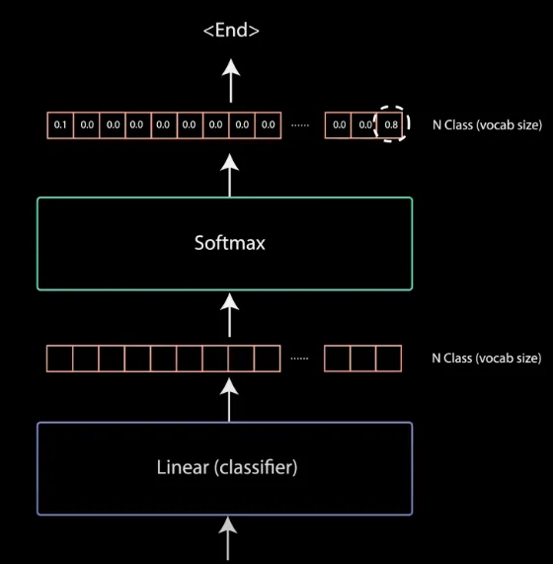
Decoder Classifier
Classifier size: number of classes
Output of classifier = input to softmax
Index of highest probability score = predicted word

Slide 26
Popular Transformer Models
Natural Language Processing
Computer Vision
Speech/Audio
BERT (Bidirectional Encoder Representations from Transformers) [Google]
GPT (Generative Pre-trained Transformer) [OpenAI]
T5 (Text-to-Text Transfer Transformer) [Google]
RoBERTa (Robustly Optimized BERT Approach) [Facebook AI]
XLNet [Google/CMU]
ViT (Vision Transformer) [Introduced by Google]
Swin Transformer (Shifting WINdows; Switchable Transformer) [Microsoft Research Asia]
DETR (DEtection TRansformer) [Facebook AI Research (FAIR)]
Conformer [Google]

Slide 27
Vision Transformer (Vi-T): Ascending from text to visual media
Traditional transformers: Text input converted to vector embeddings
Vision Transformers (ViT): Image input divided into patches, which are converted to vector embeddings
Applications:
Image Classification
Media Translation (Text/Image/Video/Audio)
Image Captioning
Semantic and Instance Segmentation
Object Detection
Anomaly Detection
Action Recognition

Slide 28
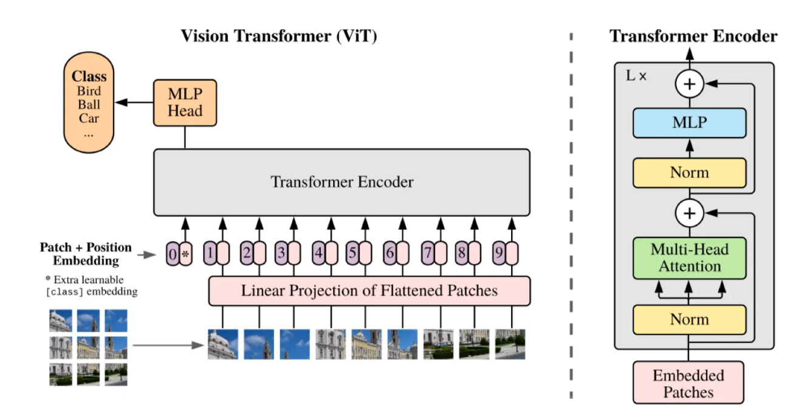
Vision Transformer

Slide 29
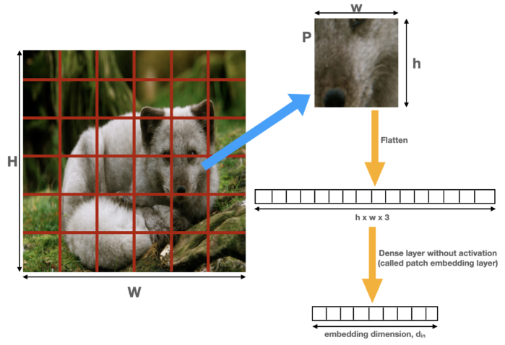
Vision Transformer: Patch Embedding (1)

Slide 30
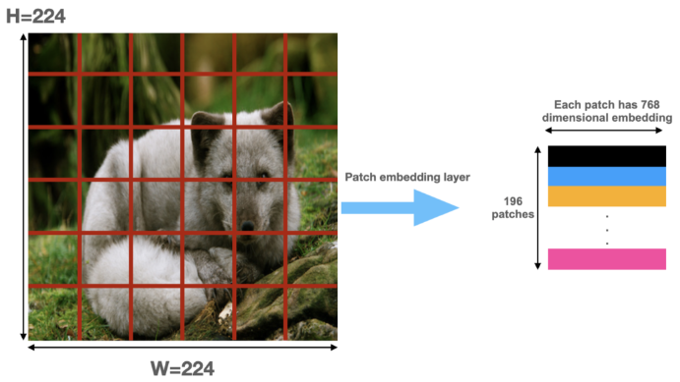
Vision Transformer: Patch Embedding (2)

Slide 31
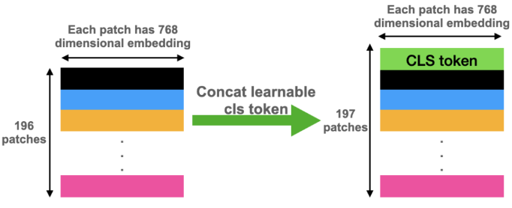
Vision Transformer: Class Embedding

Slide 32

Vision Transformer

Slide 33
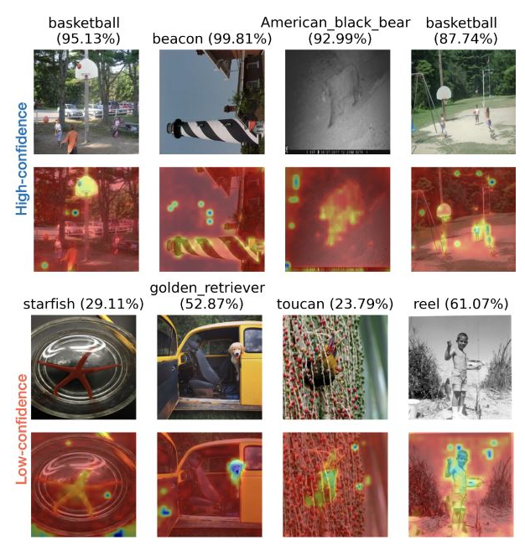
Attention Maps
Visualizations of attention weights generated from image patches
Saliency maps showing the region corresponding to highest focus of prediction (highest attention)

Slide 34
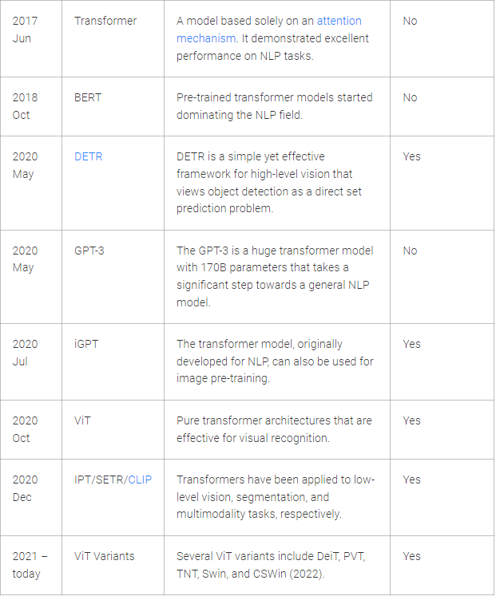
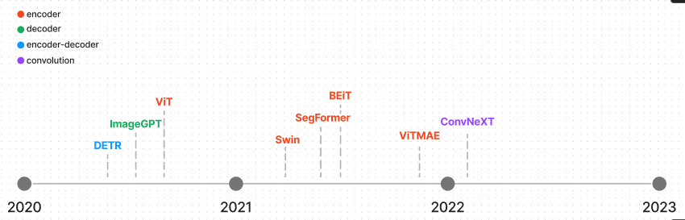
Transformers: A History
Timeline of Vision Transformers
Timeline of Popular Transformer Models

Slide 35
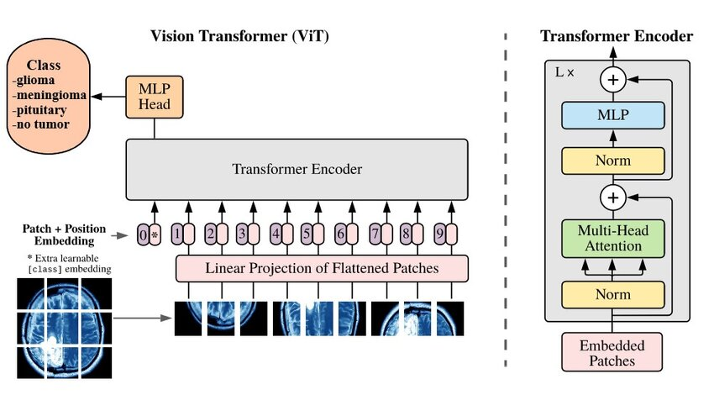
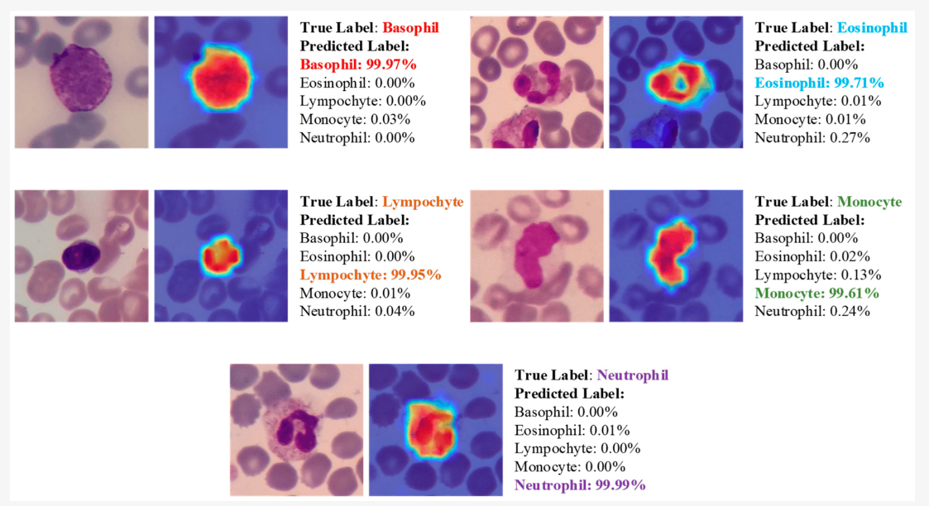
ViT Applications: Image Classification
Brain Tumor Type
Blood Cell Type

Slide 36
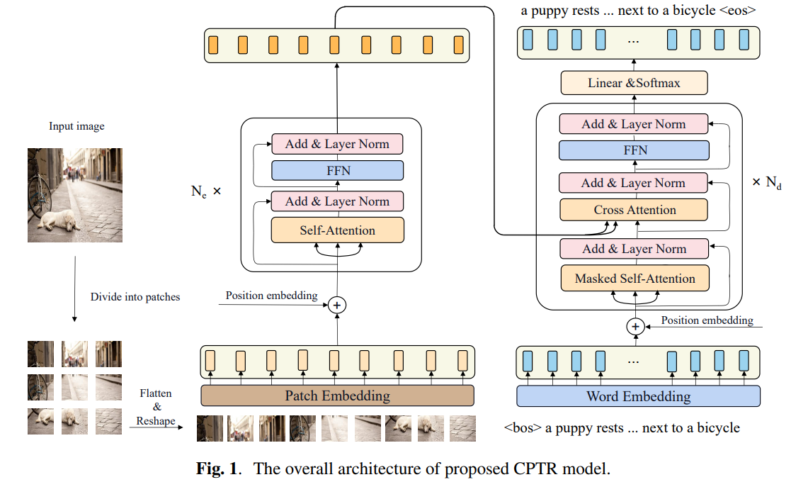
ViT applications: Image Captioning

Slide 37
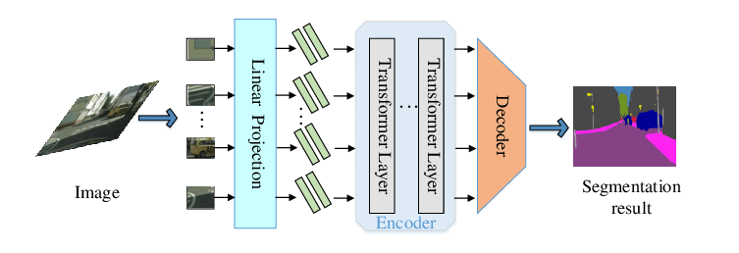
ViT applications: Semantic Segmentation

Slide 38
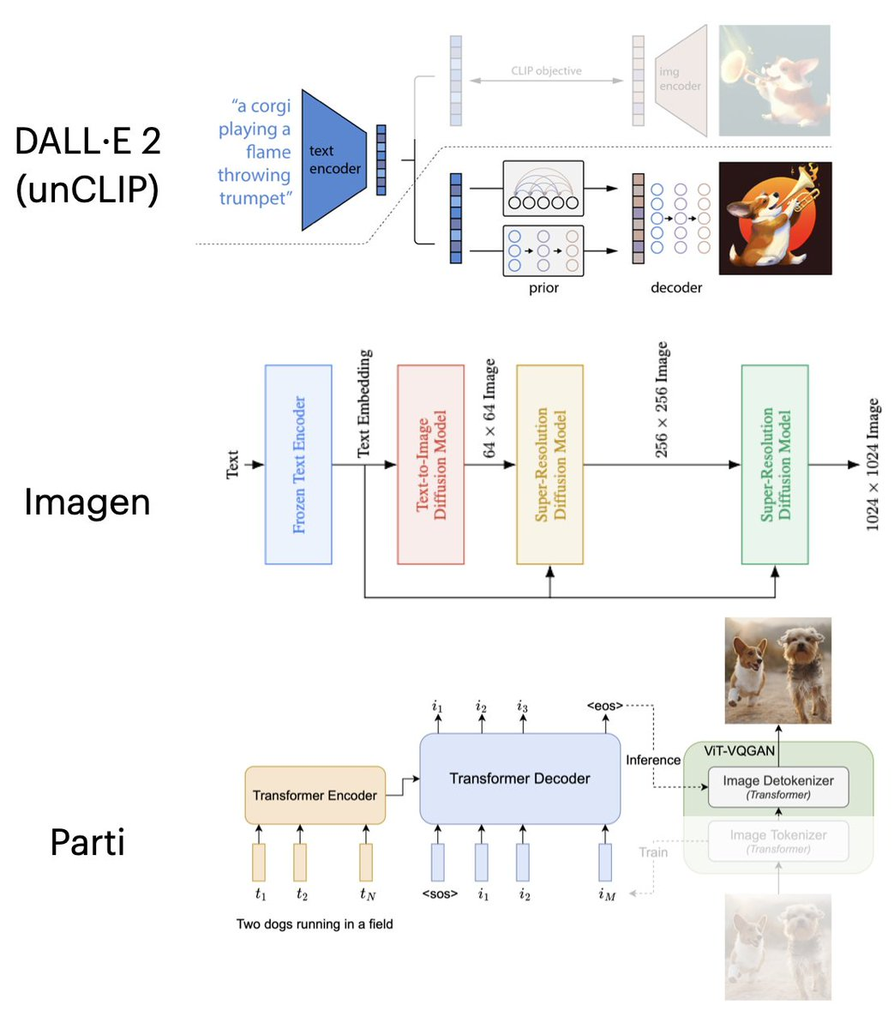
ViT applications: Text-to-Image Generation
[VQGAN = Vector Quantized GAN]

